Slide 1

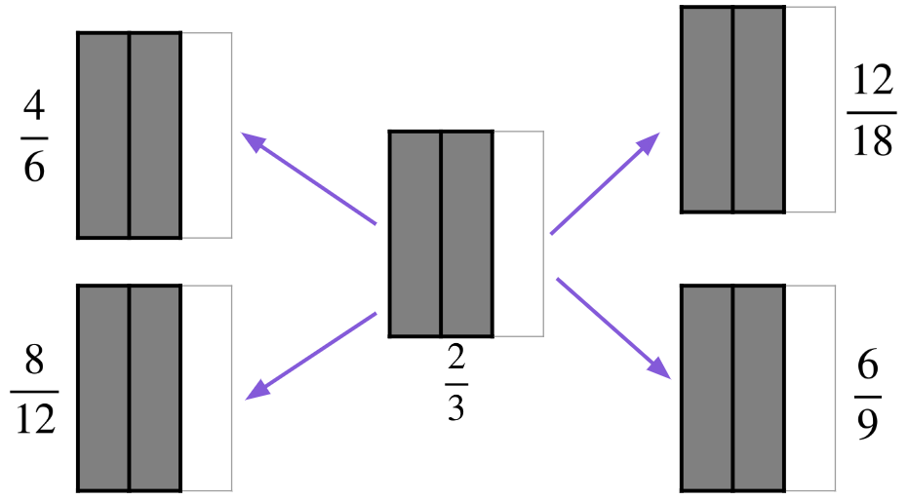



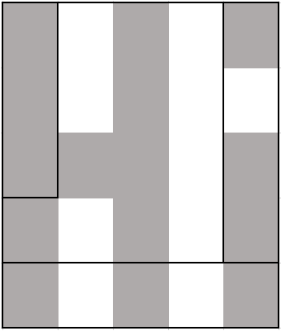
The identity property of multiplication and division
Task A: Bar models and number lines
By
subdividing,
create
fractions
that
are
equivalent
to
2)
Sam
drew
a bar
to
show
Sam then drew another bar underneath
which
shows
Sam
then
said,
“It shows
is
equivalent
to
”
Is Sam correct? Explain why.
3)
Andeep
says
is shaded. Is he correct?
You can show your working out on the diagram.

Slide 2
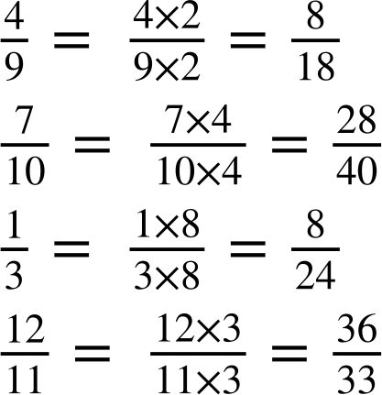


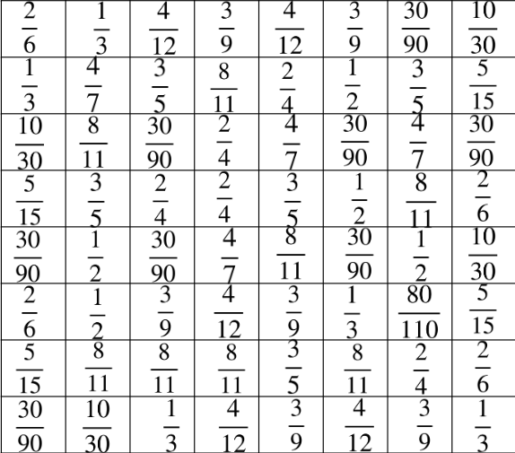









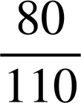
The identity property of multiplication and division
Task B: Property of multiplication
Fill in the gap to show the fraction, working out and equivalent fraction.
a)
c)
b)
d)
2)
Shade
in the
equivalent
fraction
to
to reveal a picture.

Slide 3
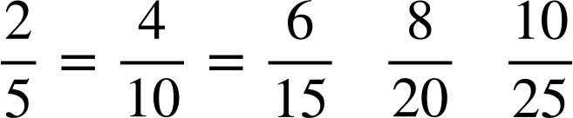
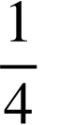
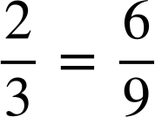
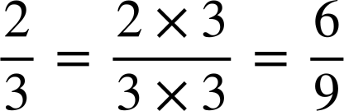
The identity property of multiplication and division
3) Here is a 5 by 5 multiplication grid.
1 | 2 | 3 | 4 | 5
2 | 4 | 6 | 8 | 10
3 | 6 | 9 | 12 | 15
4 | 8 | 12 | 16 | 20
5 | 10 | 15 | 20 | 25
Jacob uses it to help write the equivalent
fractions
to
He sees
Using the grid, can you find two more
equivalent
fractions
to
?
b)
Using
the
grid,
find
equivalent
fractions
to
4)
Show
using numbers lines, bar models and multiplication of 1
0
1
0
1
Mathematics in Education and Industry
v2.1

